Slide 1
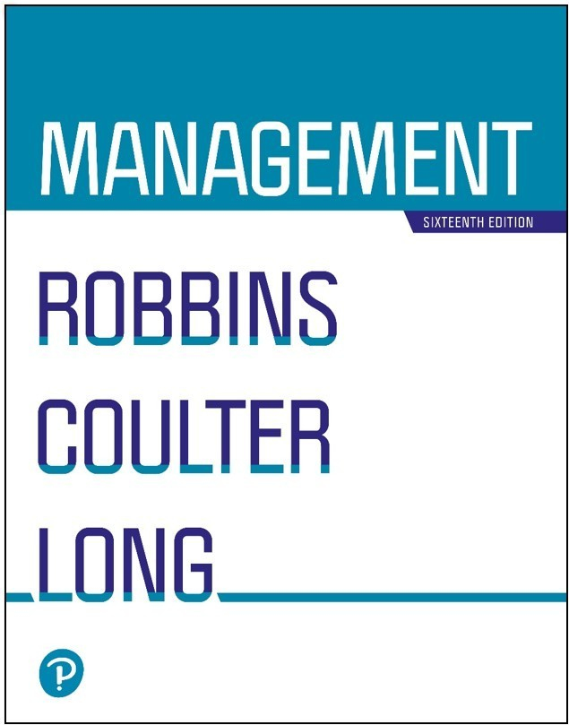

Management
Sixteenth Edition
Chapter 9
Managing Strategy

Slide 2
Learning Objectives
Define strategic management and explain why it’s important.
Explain what managers do during the five steps of the strategic management process.
Describe the three types of corporate strategies.
Describe competitive advantage and the competitive strategies organizations use to get it.

Slide 3
What Is Strategic Management?
Strategic management: what managers do to develop the organization’s strategies
Strategies: the plans for how the organization will do what it’s in business to do, how it will compete successfully, and how it will attract and satisfy its customers in order to achieve its goals
Business model: how a company is going to make money

Slide 4
Strategic Management Example.
Example: National Foods used strategic management by analyzing market trends, expanding its product portfolio, entering international markets, and investing in quality improvement.
As a result, it strengthened its competitive position and became one of Pakistan's most successful food companies.

Slide 5
Class Question????
"Should Pakistani universities prioritize improving their rankings or improving graduate employability? Can they achieve both simultaneously?”
Yes or No?

Slide 6
Why Is Strategic Management Important?
Has a positive impact on performance?
Can it be negative ?
Helps managers decide how to act in face of change and uncertainty.
How can you judge uncertainty in a product or process?
Helps complex and diverse organizations work together

Slide 7
Supporting the Strategic Management Process
Many companies believe that only the CEO and other high-level leaders should be responsible for strategy.
However, research shows broader involvement improves company performance.
Artificial intelligence (AI) might prove to be a useful tool to use when formulating strategy.
However, business managers are generally more resistant to allowing AI to generate strategy.

Slide 8
The Strategic Management Process
Strategic management process: a five-step process that encompasses strategic planning, implementation, and evaluation
Exhibit 9-1 on the following slide shows this process

Slide 9
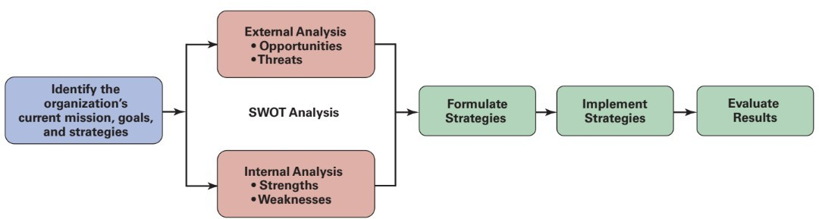
Exhibit 9-1 Strategic Management Process
Exhibit 9-1 illustrates the six-step process of strategic management, which encompasses strategy planning, implementation, and evaluation.

Slide 10
Step 1: Identifying the Organization’s Current Mission, Goals, and Strategies
Mission: the purpose of an organization
Mission statements help focus the strategic direction of the company
On the next slide you will see what should be included in a mission statement

Slide 11
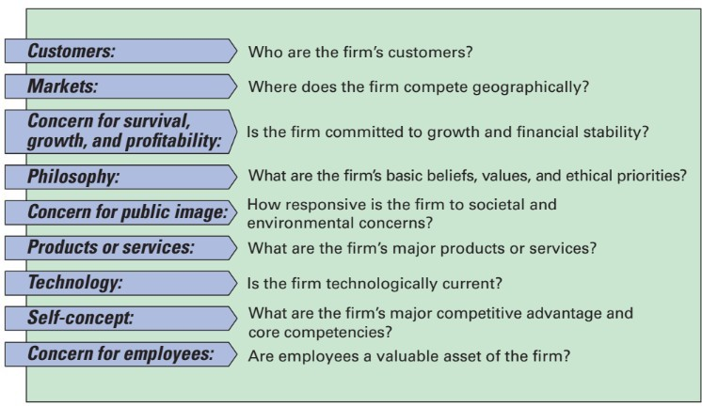
Exhibit 9-2 Components of a Mission Statement

Slide 12
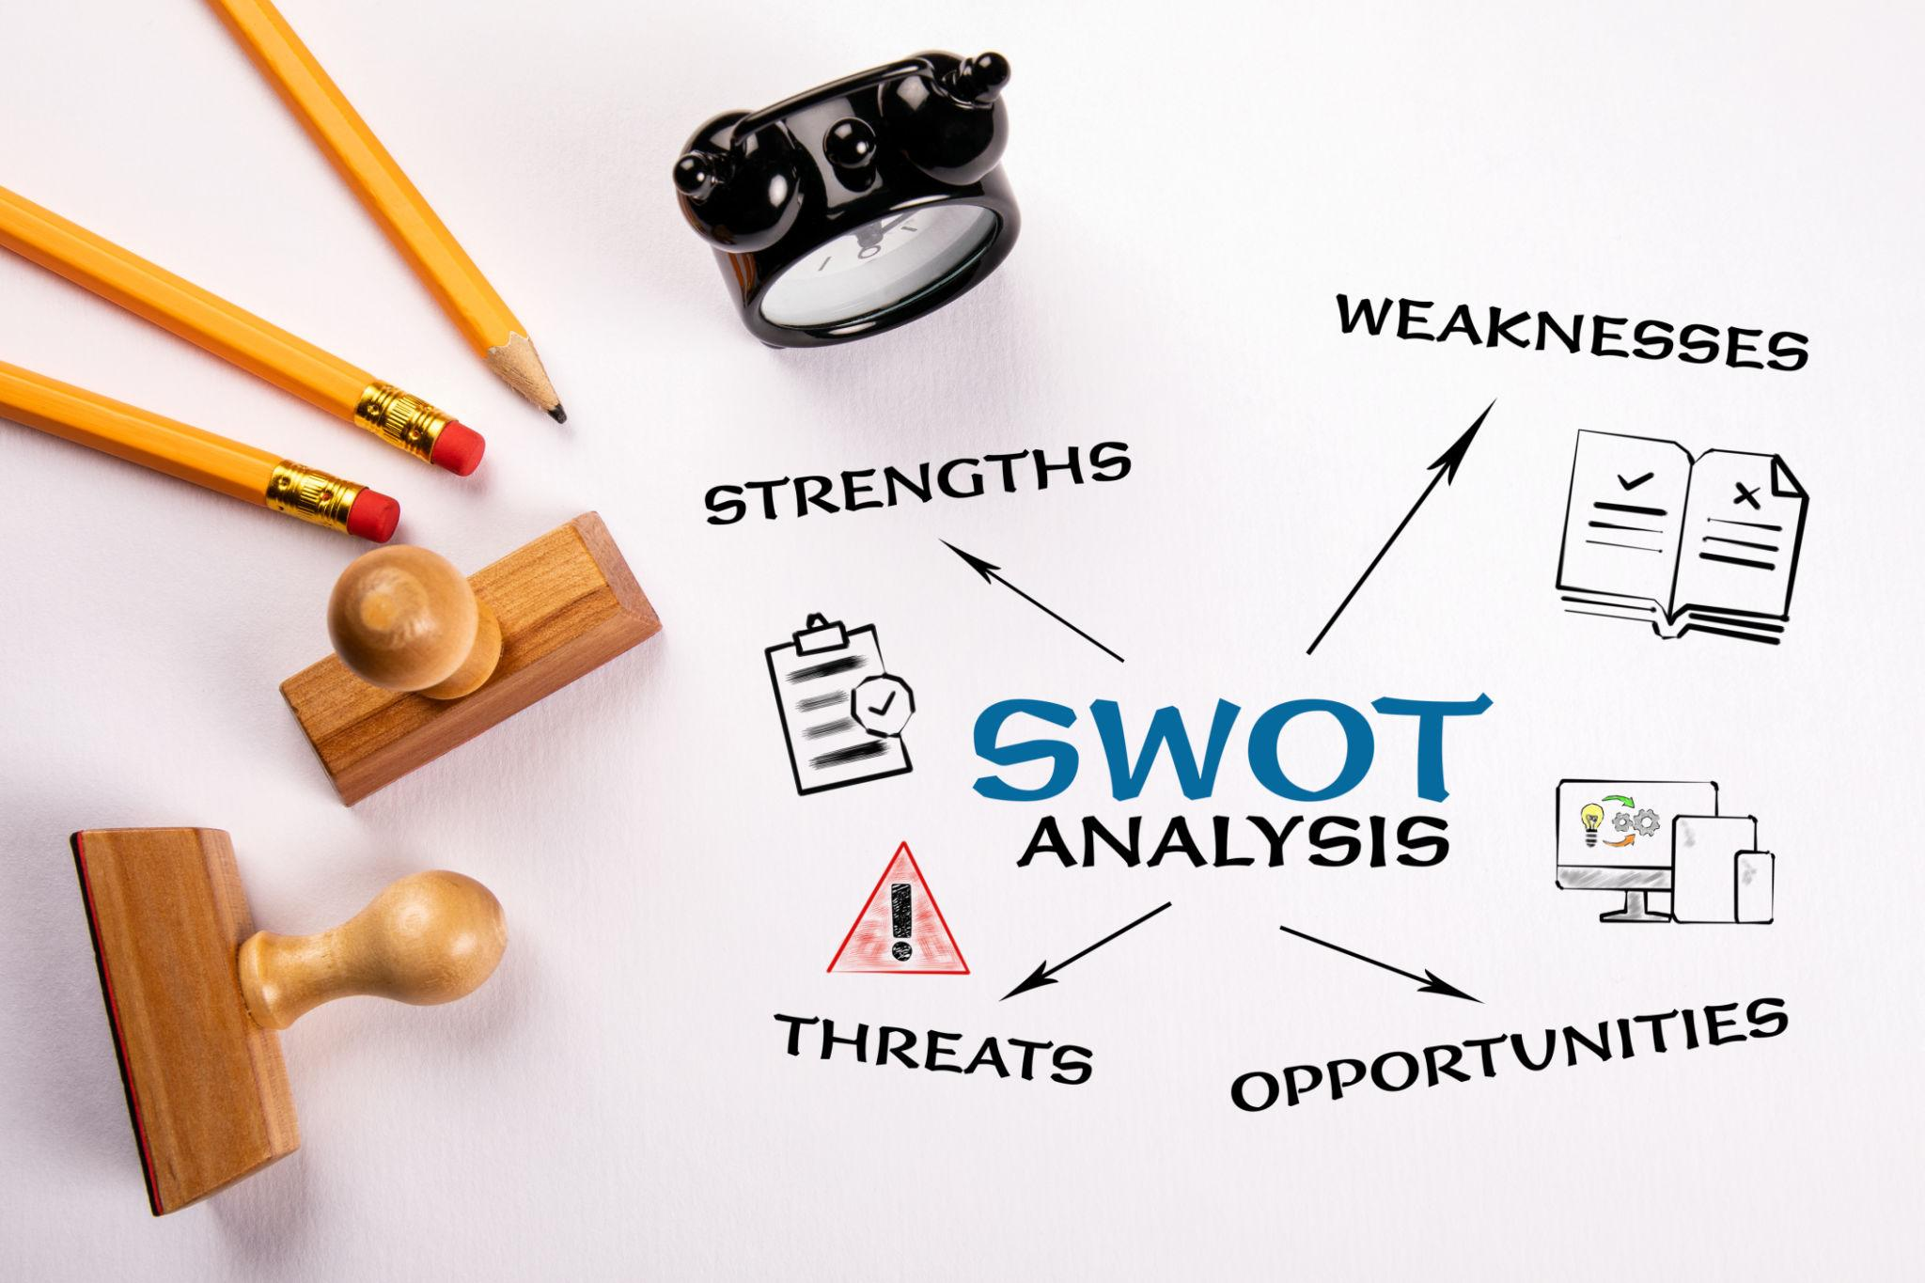

Slide 13
Step 2: SWOT Analysis
SWOT analysis: an analysis of the organization’s strengths, weaknesses, opportunities, and threats
Strengths: any activities the organization does well or its unique resources
Weaknesses: activities the organization does not do well or resources it needs but does not possess
Opportunities: positive trends in the external environment
Threats: negative trends in the external environment

Slide 14
Class Quiz????
A Pakistani university has seen a decline in admissions over the last three years.
Question: As a strategic management team leader , identify the university's possible weaknesses and propose a three-year strategic plan to increase admissions and improve its reputation.
What steps would you take to increase admission bring in more resources and funds for research and also promote research?

Slide 15
Doing an Internal Analysis
Resources: an organization’s assets that are used to develop, manufacture, and deliver products to its customers
Capabilities: an organization’s skills and abilities in doing the work activities needed in its business
Core competencies: the organization’s major value- creating capabilities that determine its competitive weapons

Slide 16
Step 3: Formulating Strategies
Three main types of strategies managers will formulate
Corporate
Competitive
Functional

Slide 17
Step 4: Implementing Strategies
No matter how effectively an organization has planned its strategies, performance will suffer if the strategies aren’t implemented properly.

Slide 18
Step 5: Evaluating Results
How effective have strategies been at helping the organization achieve its goals?
What adjustments are necessary?

Slide 19
Discussion Question…..
The Enrollment Crisis…
Admissions at your university have dropped by 30% over the last three years.
Identify at least two strengths, two weaknesses, two opportunities, and two threats.
Then propose a recovery strategy.

Slide 20
What Is Corporate Strategy?
Corporate strategy: an organizational strategy that determines what businesses a company is in or wants to be in, and what it wants to do with those businesses

Slide 21
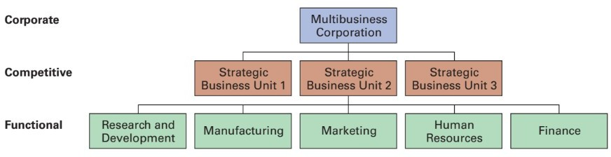
Exhibit 9-3 Types of Organizational Strategies
Exhibit 9-3 shows the three types of strategies organizations use: corporate, competitive, and functional.

Slide 22
What Are the Types of Corporate Strategy?
Growth strategy: a corporate strategy that’s used when an organization wants to expand the number of markets served or products offered, either through its current business(es) or through new business(es)
Concentration(Do what you already do, but do it better.")
Vertical integration
Horizontal integration
Diversification (Diversification is a growth strategy in which an organization enters a new business or market that is different from its current products or services.)

Slide 23
Horizontal Integration vs Vertical Integration
Feature | Horizontal Integration | Vertical Integration
Definition | A company acquires or merges with another company at the same stage of the value chain. | A company acquires or controls businesses above or below it in the supply chain.
Objective | Increase market share and reduce competition. | Gain control over supply, distribution, or production costs.
Focus | Competitors. | Suppliers or distributors.
Example | One university acquires or merges with another university. | A university creates its own publishing house, online learning platform, or student housing facilities.

Slide 24
Stability and Renewal Strategies
Stability strategy: a corporate strategy in which an organization continues to do what it is currently doing
Renewal strategy: a corporate strategy designed to address declining performance

Slide 25
How Are Corporate Strategies Managed?
BCG matrix: a strategy tool that guides resource allocation decisions on the basis of market share and growth rate of SBUs
Stars
Cash cows
Question marks
Dogs

Slide 26
Competitive Strategies
Competitive strategy: an organizational strategy for how an organization will compete in its business(es)
Strategic business unit (SBU): the single independent businesses of an organization that formulate their own competitive strategies

Slide 27
The Role of Competitive Advantage
Competitive advantage: What sets an organization apart; its distinctive edge
Competitive advantage can stem from
Quality
Low cost
Technology
Other factors

Slide 28
Sustaining Competitive Advantage (1 of 2)
Businesses must not only develop a competitive advantage but they must also sustain it.
Economic moat: sustaining competitive advantage by protecting long-term profits and market share using various means.
Simple Definition can be :
An economic moat is something that makes it difficult for competitors to take away a company's customers, profits, or market position.
Economic moat was a term popularized by Warren Buffett as a way to visualize the concept of keeping a competitive advantage.

Slide 29
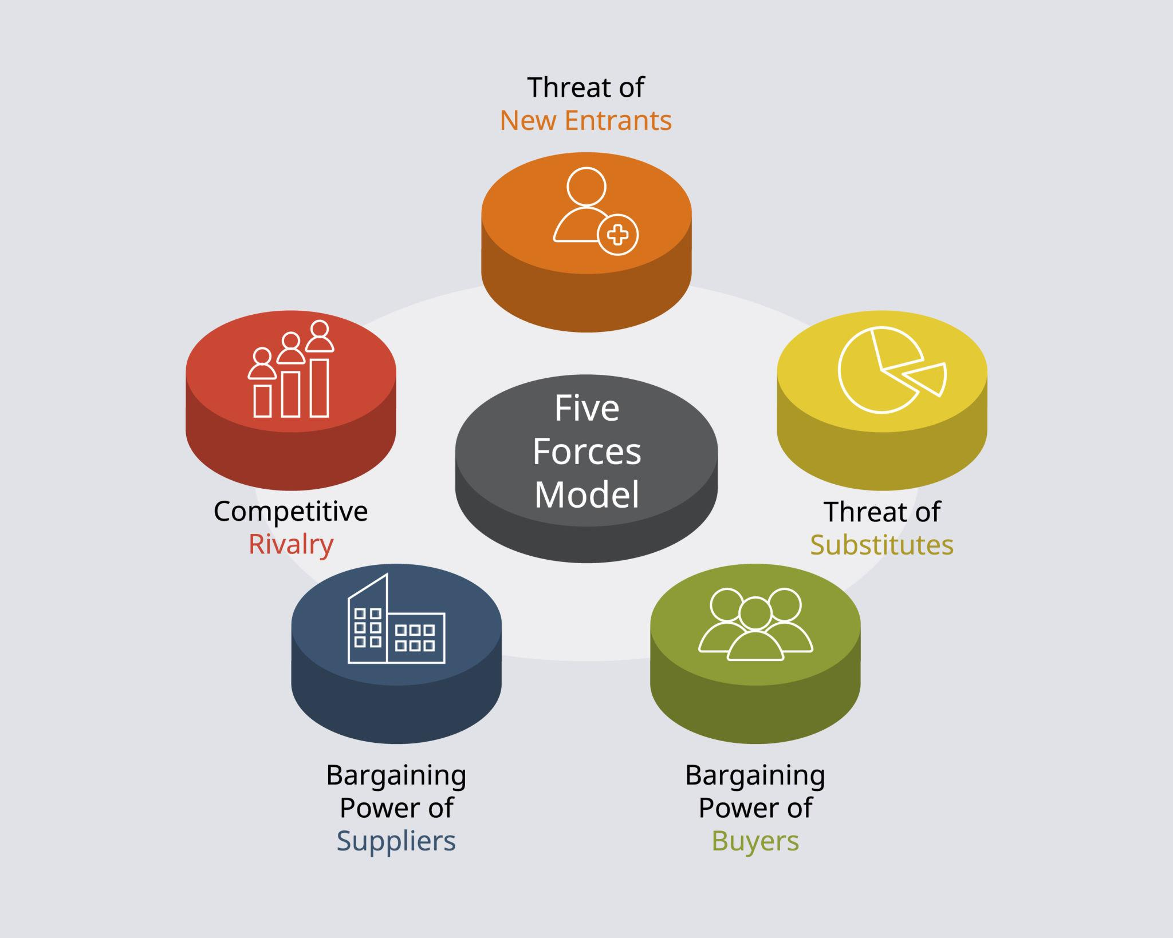

Slide 30
Sustaining Competitive Advantage (2 of 2)
Porter’s Five Forces Model:
Threat of new entrants
Threat of substitutes
Bargaining power of buyers
Bargaining power of suppliers
Current rivalry

Slide 31
Choosing a Competitive Strategy
Cost leadership strategy
Differentiation strategy
Focus strategy
Stuck in the middle

Slide 32
Examples of Differentiation Strategies
Quality
Innovation strategies
Transfer technology from one division to another
Invest in R&D
Improve the process
First mover: an organization that’s first to bring a product innovation to the market or to use a new process innovation

Slide 33
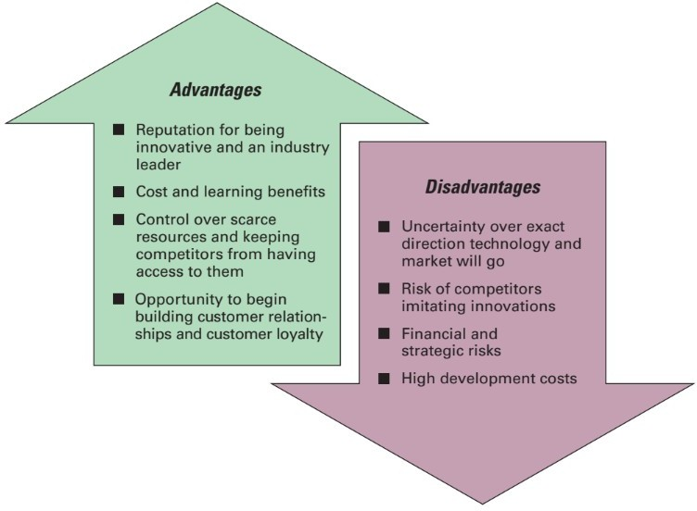
Exhibit 9-4 First Mover Advantages and Disadvantages
Exhibit 9-4 shows the advantages and disadvantages of being a first mover.

Slide 34
Other Differentiation Strategies
Customer service
Mass customization
Social media

Slide 35
Concluding Example for Discussion and Exam preparation
Imagine you are a team hired to save a struggling university.
The university has:
Falling admissions
Outdated programs
Limited budget
Strong alumni network
Good campus location
Using both SWOT Analysis and Porter's Five Forces, develop a strategy that can make the university the most attractive institution in Pakistan within five years.

Slide 36
A company has:
Strong profits.
High market share.
Loyal customers.
Excellent brand reputation.
However:
New technologies are disrupting the industry.
Competitors are innovating faster.
Customer preferences are changing.
Question: Using SWOT Analysis, Porter's Five Forces, Economic Moat, Concentration, Diversification, Horizontal Integration, and Vertical Integration, explain why a company that appears successful today may be strategically weaker than a company that is currently struggling.

